Slide 1
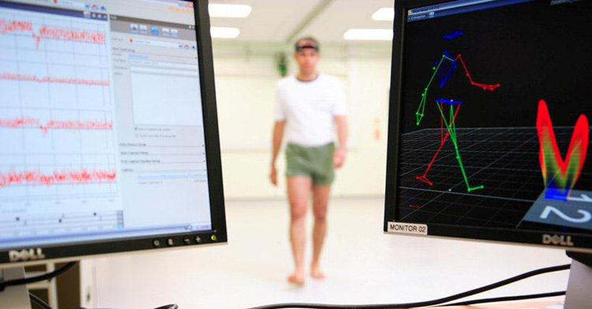
PHASE-BOUNDED GAIT EVENT DETECTION AND PREDICTION
DURING STW TRANSITION USING MACHINE LEARNING
Presented by: Mohammad Almajali
Supervised by: Dr. Hani Muhsen
Department: Mechatronics
University: German Jordanian University
Notes:
This project focuses on gait phase classification using wearable sensors, combining biomechanical modeling with machine learning.

Slide 2
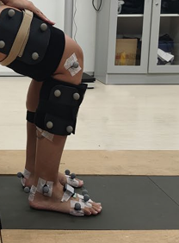
System Overview
sEMG Sensor
Foot IMU

Slide 3
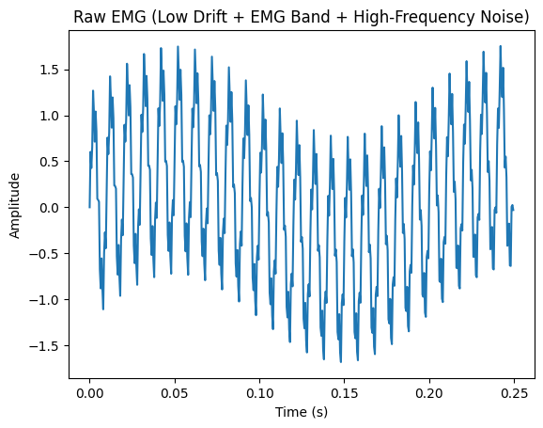
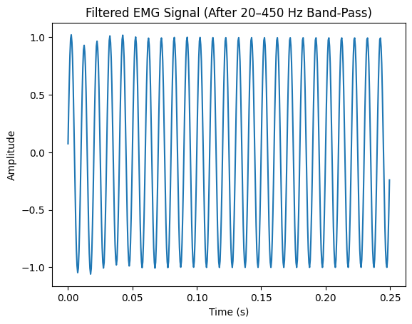
Signal Processing

Slide 4
Feature Extraction
Feature | Type | Formula / Definition | What it Represents
RMS (Root Mean Square) | Time-domain | √(mean(x²)) | Signal power / muscle contraction strength
IEMG (Integrated EMG) | Time-domain | Σ | x
MAV (Mean Absolute Value) | Time-domain | mean( | x
WL (Waveform Length) | Time-domain | Σ | x(n) − x(n−1)
ZC (Zero Crossings) | Time-domain | Number of sign changes | Frequency-related activity
SSC (Slope Sign Changes) | Time-domain | Changes in slope direction | Signal shape complexity
PF (Peak Frequency) | Frequency-domain | Frequency at max PSD | Dominant muscle firing frequency
TP (Total Power) | Frequency-domain | ∫ PSD(f) df | Overall energy in frequency domain

Slide 5
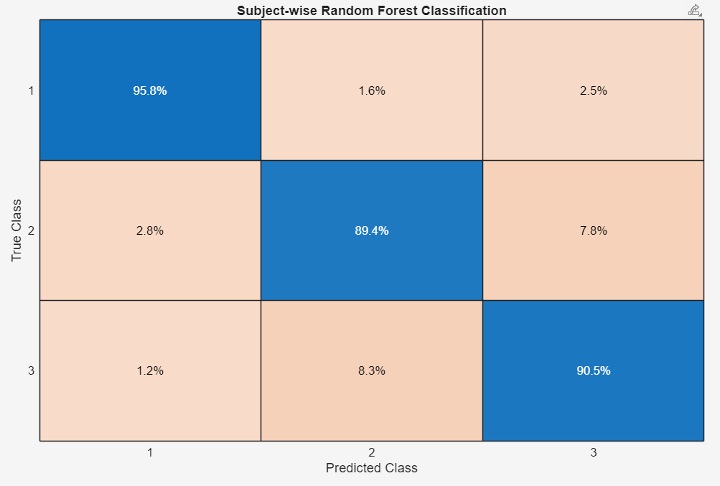
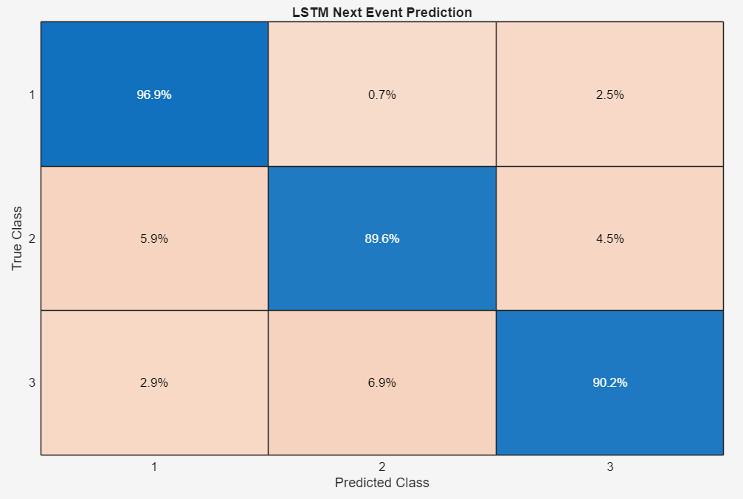
Machine Learning
(TO)
(TO)
(MSw)
(MSw)
(HS)
(HS)

Slide 6
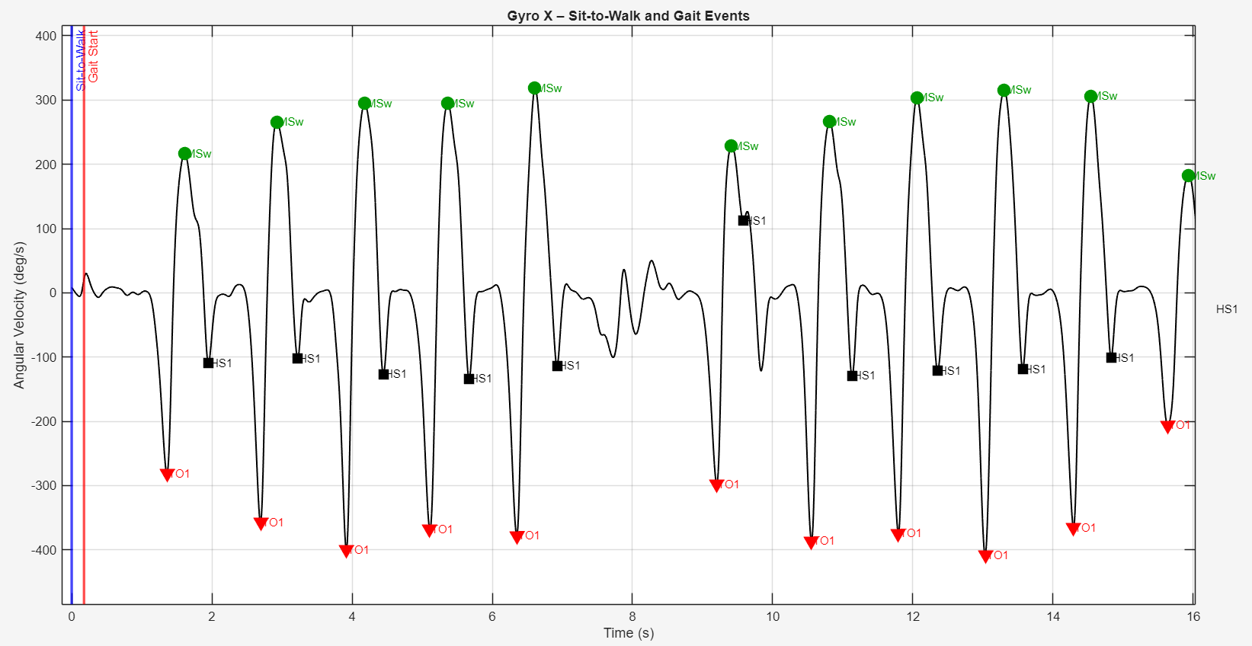

Slide 7
